Slide 1
Why Hybrid Search ?
Vector search are efficient is fetching document with similar words (Ex: learning about underwater activities) - Can pull documents related to scuba
However, vector stores are not much efficient in case of keywords . (ex: compliance@xyz.com) .

Slide 2
Hybrid Search
Utilizes both sparse and dense scheme
BM25 retriever and Vector similarity
Note: sparse and dense search can be done in parallel

Slide 3
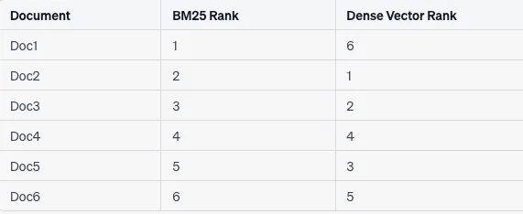
Hybrid Search

Slide 4
Reciprocal Rank Fusion (RRF)
RRF_score = 1 / (alpha_dense/rank_dense + (1-alpha)/rank_sparse)

Slide 5
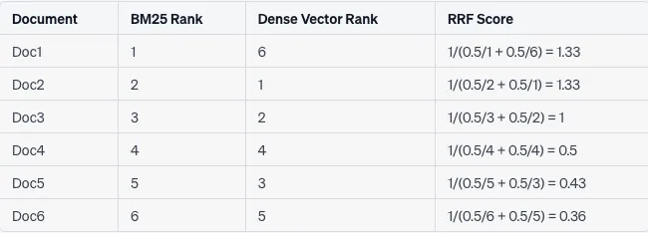
Reciprocal Rank Fusion (RRF)

Slide 6
Edge Cases
What if the doc X is retrieved in Keyword search and not in vector search.
In such case, the rank for the vector search is assigned with the Highest number and it penalizes the RRF score

Slide 7
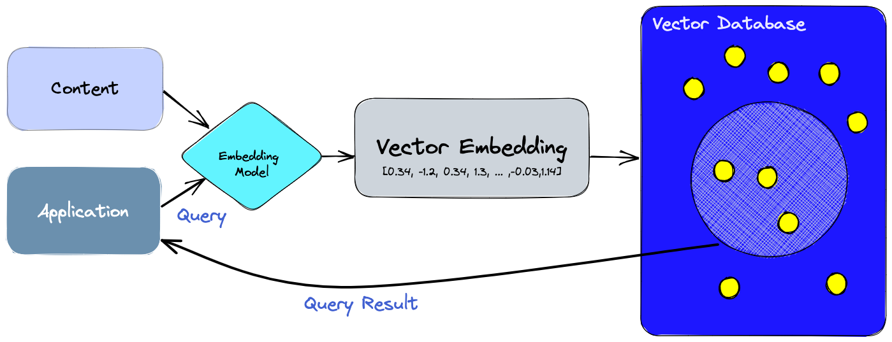

Slide 8
Vector Databases
Standalone vector indices like FAISS (Facebook AI Similarity Search) can significantly improve the search and retrieval of vector embeddings, but they lack capabilities that exist in any database. Vector databases, on the other hand, are purpose-built to manage vector embeddings

Slide 9
Advantages
CRUD operations
Scalability
Metadata filtering
Backups
Access Control

Slide 10
Indexing
A vector database uses a combination of different algorithms that all participate in Approximate Nearest Neighbor (ANN) search. These algorithms optimize the search through hashing, quantization, or graph-based search.

Slide 11
Serverless
Separating storage and compute reduces cost
Multitenancy
Freshness

Slide 12
